Slide 1
Tower Safety & Awareness
SHACOG Technical Rescue Team

Slide 2
Background
What is the South Hills Area Council of Governments
  22 Municipalities
  300K+ Population Base
  220+ square miles
  Career and Volunteer Public Safety Agencies (40+ Fire and EMS Agencies)
Technical Rescue Team Founded 2008
2015 Rescue Service of the Year
3 hams on the team

Slide 3
Objectives
Common Tower Type Overview
General Hazards / Safety
Proper Personal Protective Equipment
Climbing Preparations / Proper climbing Technique
Ground Personnel
Types of Emergencies / What to do in case of Emergency

Slide 4
Why are we Here?
Tower Climbing is a High Risk Low Frequency Event from a rescue stand point
  High Consequence + Low Margin for Error
  Tower Climbing is not something any particular amateur is doing “every” day
Lee Parsons III (N3LPJ) was killed in 2019 during a tower installation project
  http://www.arrl.org/news/pennsylvania-radio-amateur-dies-in-tower-installation-mishap
Rescues are challenging and can be labor intensive depending

Slide 5
Fatality Rates: Commercial vs Amateur*
Commercial
Est 300K commercial towers in US
5.2K FTE workers: 10,360,000 hours
Deaths
  93 from ‘03-’11 (9 years)
  10.3 deaths per year
199 deaths / 100K FTE Workers / Year
Amateur
Est 38K Amateur towers in US
24 hours / tower / year
Est 456 FTE climbers: 912,000 hours
Deaths
  4 in 12 months (‘18-’19) (17 since 2000)
878 deaths / 100K FTE Workers / Year
*Data was taken second hand from Jim Idelson Presentation which sourced the data from OSHA and PBS Frontline Pro-Publica

Slide 6
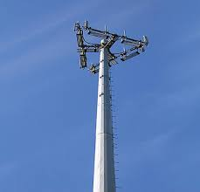
Common Tower Types:
Monopole
Single Tube Structure
Multi-Section
100-200 ft
Hard to climb
Difficult for rescue due to structure
Limited Access

Slide 7
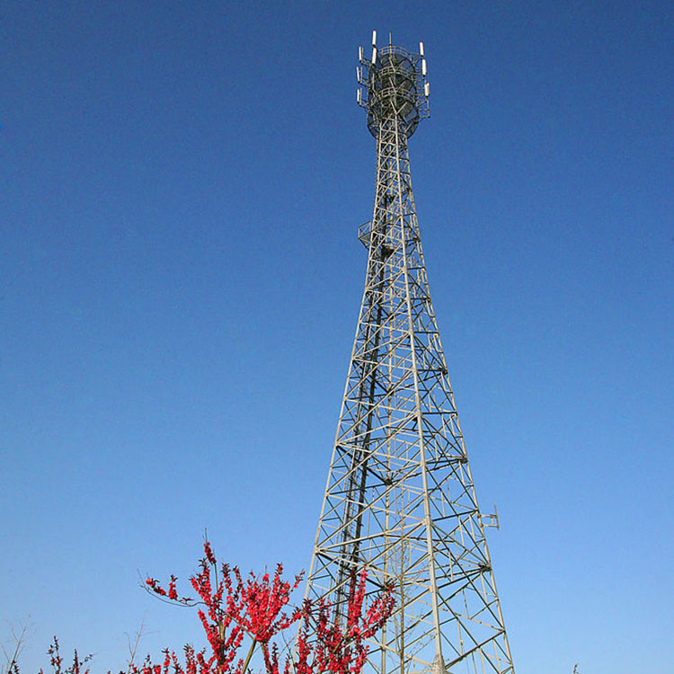
Common Tower Types:
Self-Supported
Triangular or Square Base
Often Tapered
200-400 ft
One leg typically has an integrated safety system in commercial
Easiest of towers to climb and work on

Slide 8
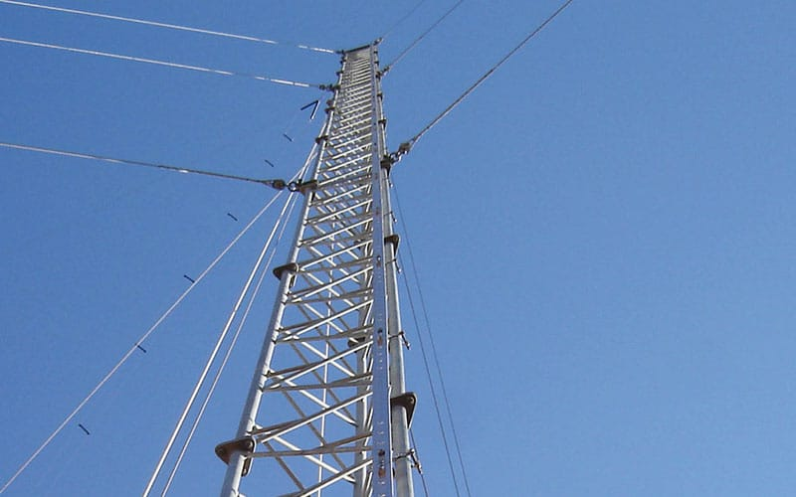
Common Tower Types:
Guyed
Rise from a single point
Supported by guy wires
Can reach in excess of 2000’ feet
Most common in amateur radio
Rescue may be complex based on height.

Slide 9
Common HAzards
Falls
RF Exposure
Electrical
  https://hackaday.com/2020/04/16/a-dangerous-demonstration-of-the-power-of-radio/
Physical | Cognitive
Fatigue, Chills, Dizziness, Burning Sensation, Extremity Tingling, Unusual Thirst | Uncertainty, Confusion, Concentration Loss, Memory, Poor Attention/Problem-Solving

Slide 10
Proper Personal protective Equipment
Helmet
Eye Protection
Gloves
Fall Protection Harness
Positioning
“Good” footwear
ARRL Handbook (2013 ed.) has fairly limited information on this topic
OHSA 1926.502(d)(21)Personal fall arrest systems SHALL be inspected prior to each
use for wear, damage, and other deterioration, and defective
components SHALL be removed from service.
6.1 Inspection6.1.1 Equipment SHALL be inspected by the user before each
use and, additionally, by a competent person other than the
user at intervals of no more than one year.
https://falltech.com/training-education/fall-protection-topics-videos/

Slide 11
100% Attached + Fall Arrest
100% attached means that you are always connected to the tower by something other than your hands/feet.
This isn’t a guideline; It’s a NON-NEGOTIABLE Requirement
Fall Arrest reduces potential of major injuries
Proper Dual Fall Arrest Lanyard Technique
Bad Example from DX Engineering

Slide 12
Preparations before Climbing
Climber
DON’T CLIMB ALONE
Dress for Success
  Proper PPE
  Proper clothing for weather
  Sunscreen
  Pre-Use Inspection of PPE
Have a Plan – What is going to be done, how is it going to be done.
Ground Support Person(s)
Tower Climber is in Charge
Don’t do anything unless directed by climber
PACE Plan
ABCDEFG
  Anchors, Bodywear, Connection, Devices, Edge Protection, Force Check, Good to Go

Slide 13
Emergencies!
Climber Illness/Medical Emergency
  Anaphylaxis
Fall of a Climber
  Suspension Trauma
Equipment Misuse or Malfunction
Trespasser/Unauthorized Access
Information to Gather
Reason for Response
Type of Tower
Height of Patient and Height of Tower
Patient Contact / Level of Consciousness
Secured to Structure
Known Medical Conditions
Known Hazards

Slide 14
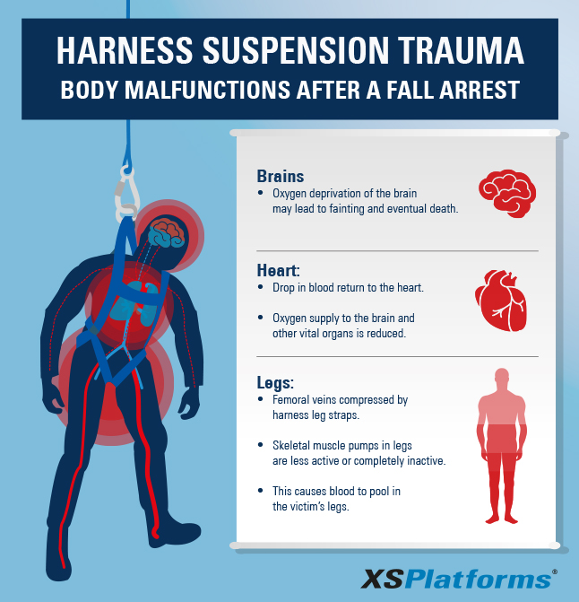
What is Suspension Trauma?

Slide 15
What you can do to help!
Bleeding Control - Direct Pressure
Bleeding Control - Wound Packing
Bleeding Control - Tourniquet
Stop the Bleed
CPR
Call 911

Slide 16
Additional Information and Sources
SHACOG Website: https://www.shacog.com
Elevated Safety: https://elevatedsafety.com/
ARRL:
  http://www.arrl.org/news/new-england-radio-amateur-hosts-video-on-tower-safety
  ARRL Handbook Chapter on Safety (Chapter 28 2013 Ed.)
Zero Falls Alliance: https://zerofalls.org/
The Driven Element: https://blog.thedrivenelement.com/
Text Resources Available:
  https://www.arrl.org/shop/Antenna-Towers-for-Radio-Amateurs/
  https://www.championradio.com/UP-THE-TOWER-The-Complete-Guide-To-Tower-Construction.1
  ARRL September 2021 QST Magazine

